Slide 1


Import – Export Extension

Slide 2
Import – Export Extension
Purpose:
Import- Export extension is to retrieve dataset from local neo4j and have the dataset in a csv file format. Edit the csv file and import the newly edited dataset back to Neo4j.
The csv file will contain a 2D-table of the type nodes and the relationship weight values between two nodes.
Editing the csv file and importing back to Neo4j, will have the output graph in Neo4j reflecting the edited csv file.

Slide 3
How to run:
The code of this extension is under the folder name: Friendly-Neo4j-Exporter
This extension uses maven, to build a jar-file, run: mvn clean package
A jar-file will be available under the directory named “target” [\Friendly-Neo4j-Exporter\target]
Stop services of Neo4j Graph database before copying the jar file to the plugin directory
Copy the jar-file named “friendly-neo4j-exporter-20.0.jar” to the “plugin” directory of your Neo4j instance.
Restart the service of Neo4j Graph database
Refer to neo4j.log if Import-Export function does not run.
At local Neo4j you can start calling the procedure of the import-export function.

Slide 4
Configuration File
Under the “resources” [\Friendly-Neo4j-Exporter\src\main\resources] directory of Friendly-Neo4j-Exporter, a configuration file, named “config.properties”, contains a list of global variables used in this extension.
Edit the configuration file’s variables based on the properties of the dataset that will be used
After editing the configuration file run mvn clean package and do the steps from previous slide.

Slide 5
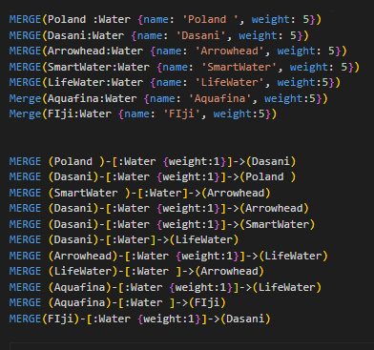
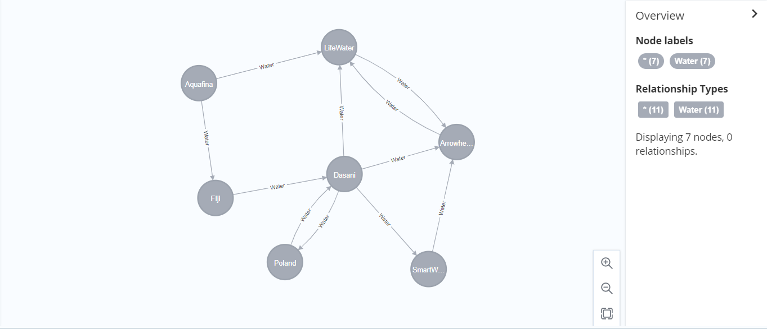
Example:
A dataset example
Running the dataset in local Neo4j will give this output graph

Slide 6
Export function:
Export function will give an output of a 2D table, where the x and y- axis is the type of the node and the relationship weight of between the two nodes.
Procedure: CALL fexporter.save.types([“labels”],”type”,”path”, “filename);
Example: CALL fexporter.save.types(["Water"],"name", "C:\Users\Desktop", “result")
A successful run of the query will give an output message of , "A new zip file has been created under 'C:\Users\Desktop\result.zip’”
A new zip file containing the csv file will be created under the path given.

Slide 7
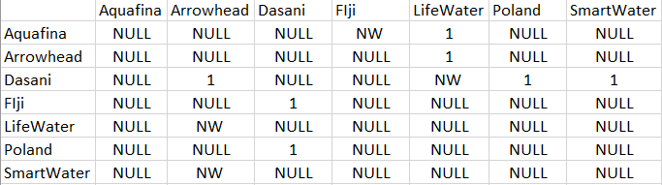
Output of the Export Function:
NOTE:
NULL -> Relationship does not exist
NW -> [no weight] relationship exist but does not have a weight value
x and y-axis are the name of the nodes , where y-axis is the source node and x-axis is the end node
The values between the x and y-axis are the relationship weight values between two nodes
The relationship of y=Aquafina and x= Poland is NULL indicating no relationship is present

Slide 8
Import Function
The Import Function will retrieve the data from the csv file and create a graph based on the csv file
To edit the csv file: extract the csv file from the zip file, edit the csv file, and zip the csv file again.
Procedure: CALL fexporter.type.load(“Path”);
Example: CALL fexporter.type.load("C:\\Users\\Desktop\\result.zip")
A successful run of the query will give an output message of: "Zip file imported.“
A newly created graph will be available in local Neo4j.

Slide 9
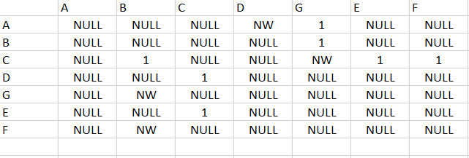
Import Function:
Original dataset, before modifications
Current dataset, with modifications on the node names

Slide 10
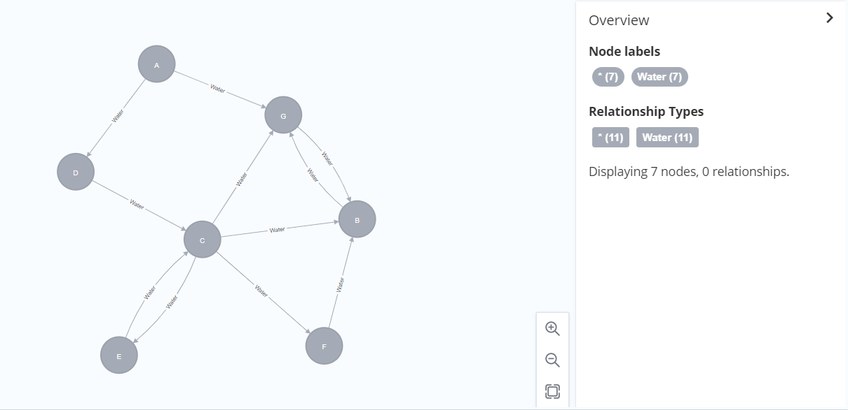
Output of the Import Function:
Original graph, before any modifications of the dataset.
7 Nodes
11 Relationships
Current graph, after modifications of the dataset.
7 Nodes
11 Relationships

